Slide 1
Project Title: QR Code Generator
Project Overview:
This project aims to create a Python program that generates QR codes for given input data. QR (Quick Response) codes are two-dimensional barcodes that encode information such as text, URLs, or other data
Features:
1. Generate QR codes for text input.
2. Generate QR codes for URL input.
3. Option to customize QR code size.
4. Option to save the generated QR code as an image file.

Slide 2
Libraries Used: 1. `qrcode`: A Python library to generate QR codes. 2. `Image` : A Python library Used to save the generated QR code as an image file.
Installation:
Ensure Python is installed on your system.
Install the ’qrcode’ library using pip:
pip install qrcode

Slide 3
Usage: 1. Run the `qr_code_generator.py` script. 2. Enter the data for which you want to generate the QR code (text or URL). 3. Choose the size of the QR code (default or custom). 4. If custom size is chosen, specify the width and height. 5. The generated QR code will be displayed on the screen. 6. Optionally, you can save the QR code as an image file.

Slide 4
Example Code:
import qrcode
import image
qr=qrcode.QRCode(
version=15,
box_size=10,
border=5
)
data="https://www.facebook.com/mehedi.hasan.saikot.106/"
qr.add_data(data)
qr.make(fit=True)
img=qr.make_image(fill="black",back_color="white")
img.save("qrcode1.png")

Slide 5
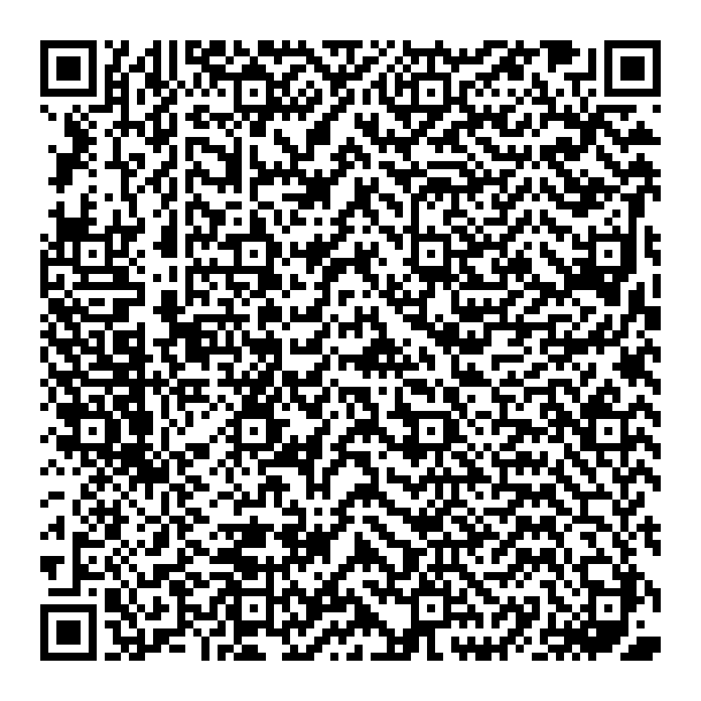
Conclusion:
This project provides a simple QR code generator in Python using the
‘qrcode’ library. Users can generate QR codes for various types of data and customize the size of the QR code as per their requirements. It's a useful tool for generating QR codes for personal or business use.

